Slide 1
SEQUENTIAL CIRCUIT
SR LATCH (NOR)

Slide 2
Youtube
https://www.youtube.com/watch?v=OnS7H4pu9rc

Slide 3
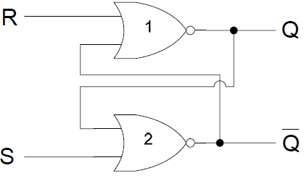
SR L ATCH

Slide 4
SR LATCH TABLE
S | R
0 | 0
0 | 1
1 | 0
1 | 1

Slide 5
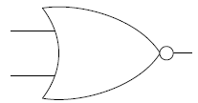
SR L ATCH
A | B | F
0 | 0 | 1
0 | 1 | 0
1 | 0 | 0
1 | 1 | 0

Slide 6
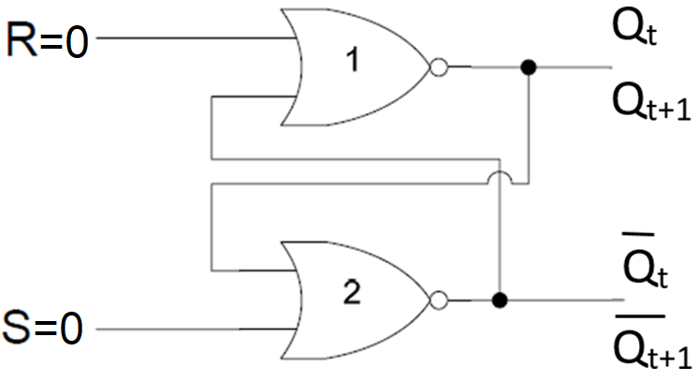
SR L ATCH
0 | 0

Slide 7
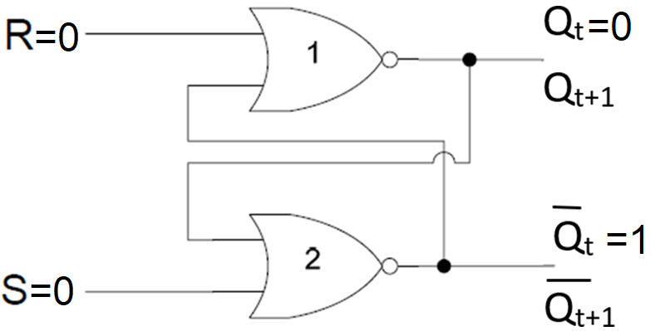
SR L ATCH
0 | 0

Slide 8
SR L ATCH
0 | 0
0
0
=0
0
=1
1

Slide 9
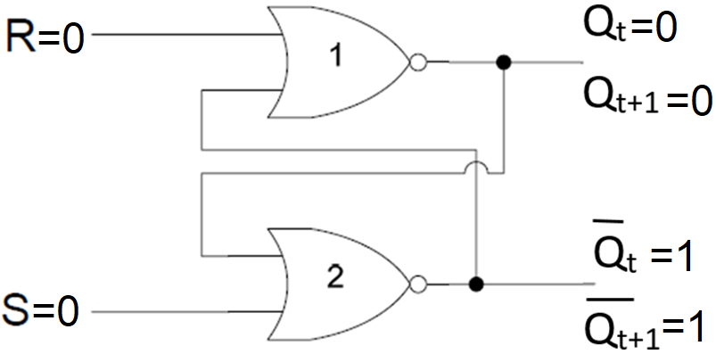
SR L ATCH
0 | 0 | 0 | 1

Slide 10
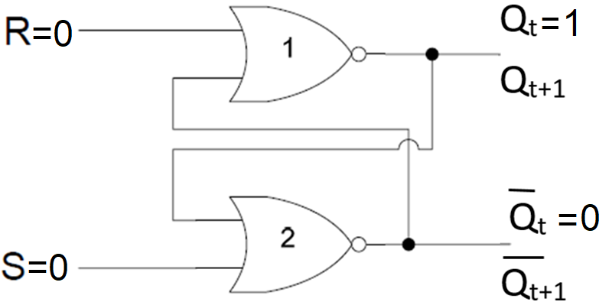
SR L ATCH
0 | 0

Slide 11
SR L ATCH
0 | 0
1
0
0
0

Slide 12
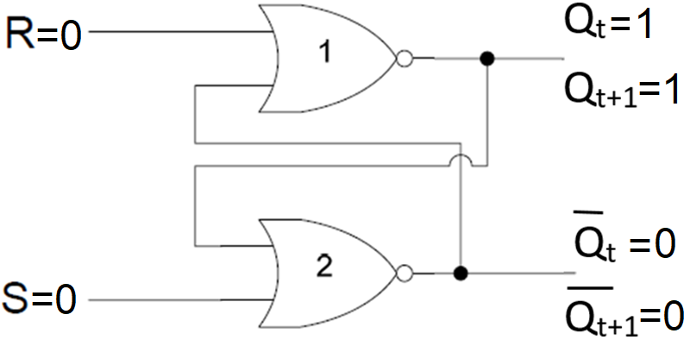
SR L ATCH
0 | 0 | 1 | 0

Slide 13
SR L ATCH
0 | 0 | 0 | 1
0 | 0 | 1 | 0

Slide 14
SR L ATCH
0 | 0
0 | 0

Slide 15
SR LATCH TABLE
0 | 0
0 | 1
1 | 0
1 | 1

Slide 16
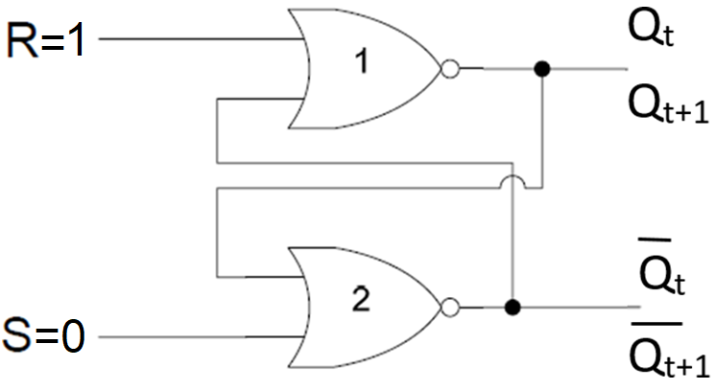
SR L ATCH
0 | 1

Slide 17
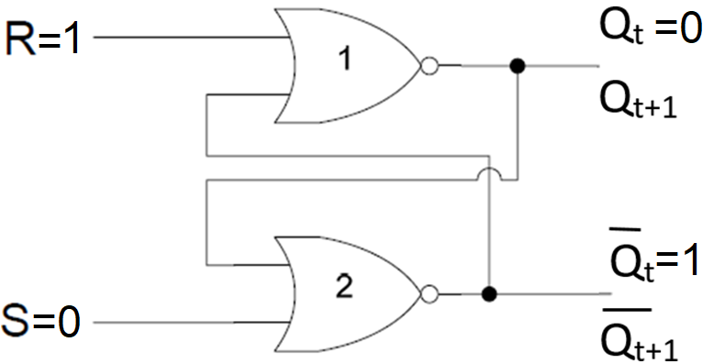
SR L ATCH
0 | 1

Slide 18
SR L ATCH
0 | 1
1
0
1

Slide 19
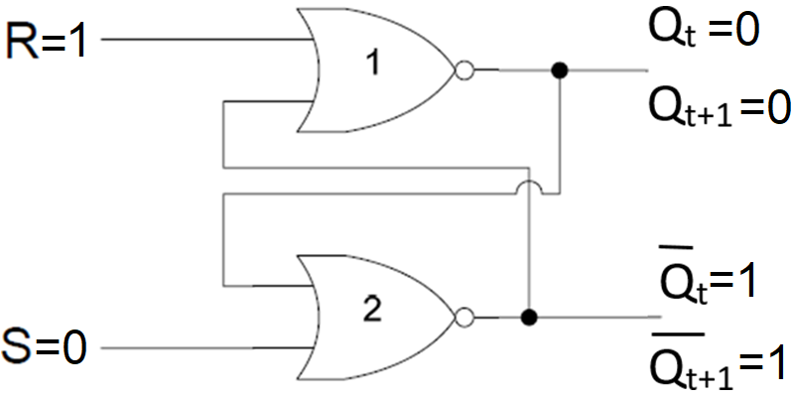
SR L ATCH
0 | 1

Slide 20
SR L ATCH
0 | 1

Slide 21
SR L ATCH
0 | 1
1
0
1

Slide 22
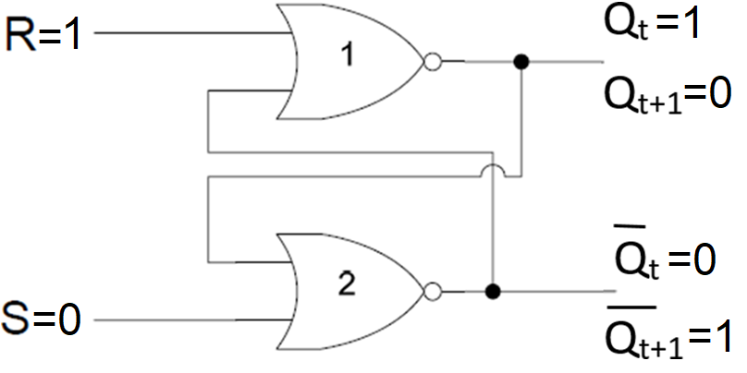
SR L ATCH
0 | 1

Slide 23
SR L ATCH
0 | 1 | 0 | 1
0 | 1 | 0 | 1

Slide 24
SR LATCH TABLE
0 | 0
0 | 1 | 0 | 1
1 | 0
1 | 1

Slide 25
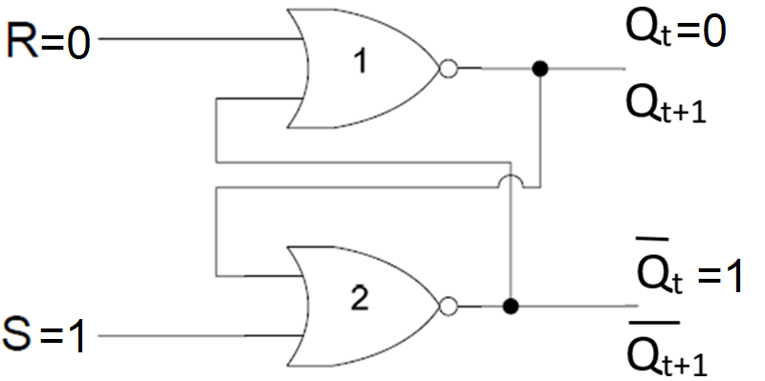
SR L ATCH
1 | 0

Slide 26
SR L ATCH
1 | 0
1
1
0

Slide 27
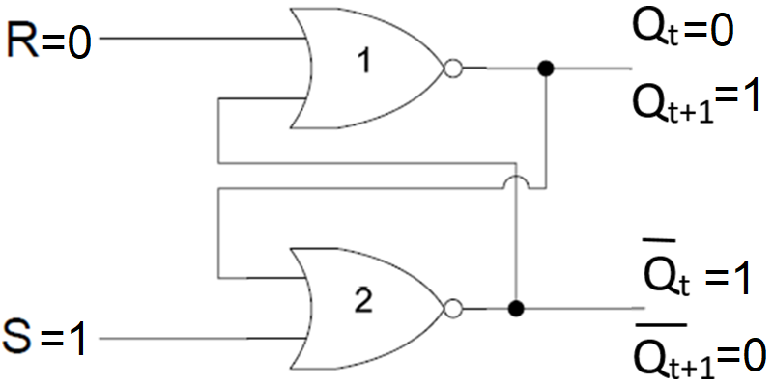
SR L ATCH
1 | 0 | 0 | 1

Slide 28
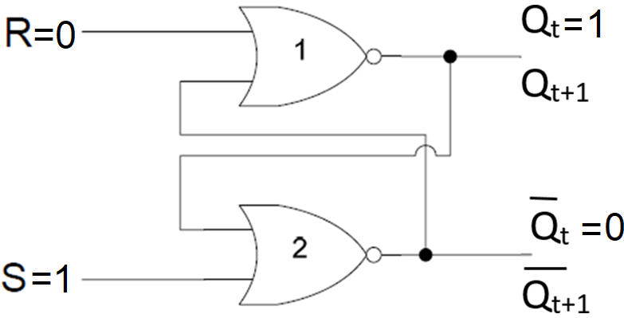
SR L ATCH
1 | 0

Slide 29
SR L ATCH
1 | 0
1
1
0

Slide 30
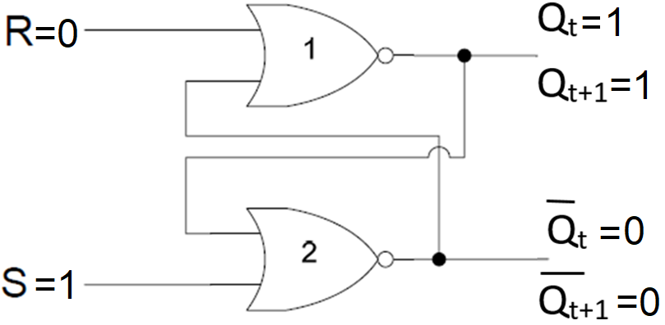
SR L ATCH
1 | 0 | 1 | 0

Slide 31
SR L ATCH
1 | 0 | 1 | 0
1 | 0 | 1 | 0

Slide 32
SR LATCH TABLE
0 | 0
0 | 1 | 0 | 1
1 | 0 | 1 | 0
1 | 1

Slide 33
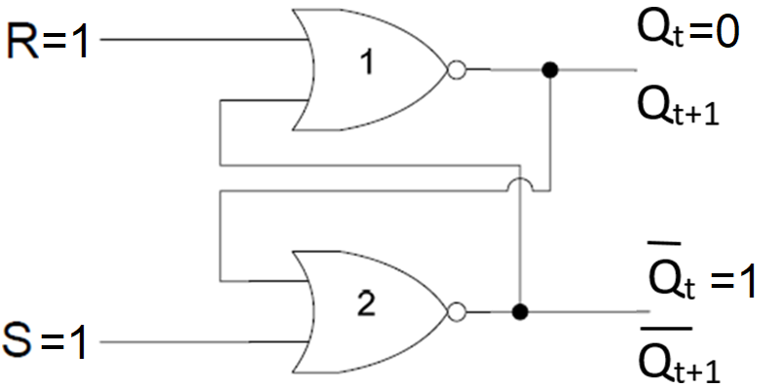
SR L ATCH
1 | 1

Slide 34
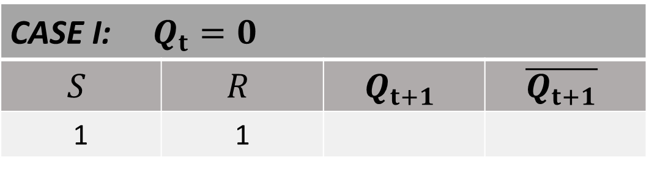
SR L ATCH
1 | 1
1
0
0
1

Slide 35
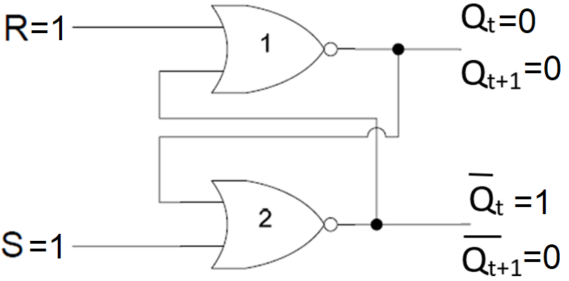
SR L ATCH
1 | 1 | 0 | 0

Slide 36

SR L ATCH
1 | 1

Slide 37
SR L ATCH
1 | 1
1
0
0
1

Slide 38
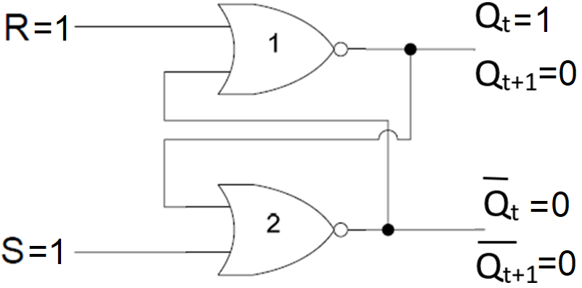
SR L ATCH
1 | 1 | 0 | 0

Slide 39
SR L ATCH
1 | 1 | 0 | 0
1 | 1 | 0 | 0

Slide 40
SR LATCH TABLE
0 | 0
0 | 1 | 0 | 1
1 | 0 | 1 | 0
1 | 1 | 0 | 0

Slide 41
SR LATCH TABLE
 |  |  |  | COMMENT
0 | 0 |  |  | NO CHANGE
0 | 1 | 0 | 1 | RESET
1 | 0 | 1 | 0 | SET
1 | 1 | 0 | 0 | INVALID CONDITION

